Slide 1

Maintenance and use of ctu retrievable packer
By :
Jalal Alali
Summer 2018

Slide 2
work content
Overview
preparation
Tool maintenance process
End of maintenance

Slide 3
Overview
Introduction of Thru-Tubing Retrievable Packer
Through the tubing packer, the tubing packer can pass through the tubing with a smaller inner diameter and pump pressure to expand and set up its own rubber, thereby achieving a temporary sealing of the target well and the target horizon. Block the blockage and then pump the liquid through the packer to the bottom of the silo. The packer can be housed inside a conventional tubing and within a larger casing below the tubing, and is typically used in routine workover operations

Slide 4
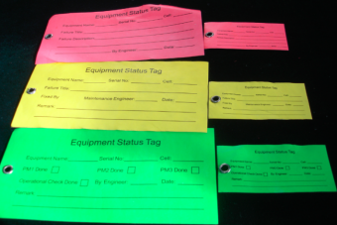
preparation
2-1 Required documents
2-1-1 Pre-Work Safety Record Sheet, See QHSE System Document,
2-1-2 Make a Tool Status label

Slide 5

preparation
2-2 Inspection Tool log sheet
Check the operation log table and run the record table to record the operation of the tool in detail, it can be used as a tool to maintain and solve specific problems, Review tool operation records before maintenance
Note: a) The tool must be maintained after use
b) Always check maintenance records before use

Slide 6
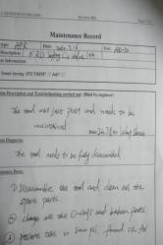
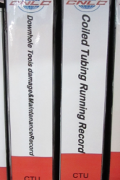
preparation
2-3 Preparation tool maintenance records
After the maintenance of the tool is completed, it is necessary to record the seals and metal parts for maintenance and replacement so that the user can understand the state of the tool after repair, analyse and judge the tool failure when problems occur, and find a solution to the problem.

Slide 7
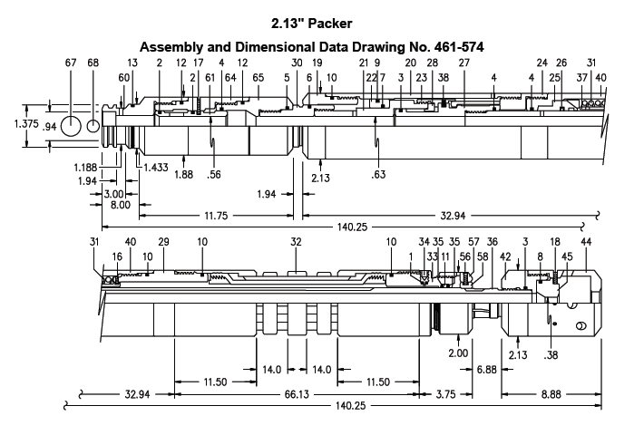
preparation
2-4 prepare the assembly drawing

Slide 8
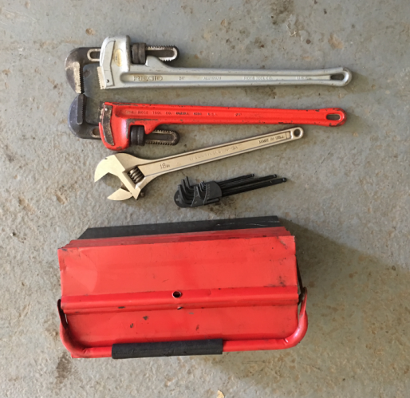
preparation
2-5 Required auxiliary equipment and related Hand tools:

Slide 9
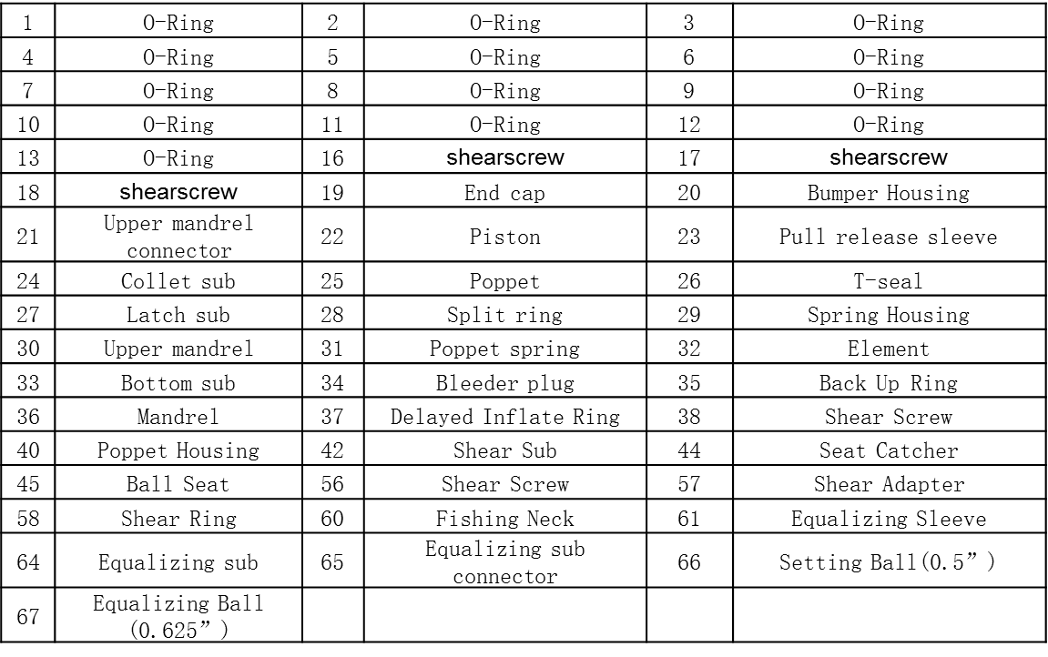
preparation
Retrievable Packer Parts list

Slide 10
Tool maintenance process
Thru-Tubing Retrievable Packer Tool maintenance special tools and commonly used hand tools
No | Tool Name | Quantity | Note
1 | Vise | 1
2 | 24”Pipe wrenches | 2
3 | Adjustable wrench | 1
4 | Allen wrench | Some
5 | Common Hand Tools | some
6 | O ring special tools | 1
RTV Packer maintenance hand tool preparation

Slide 11
Tool maintenance process
2-5 Safety related requirements
2-5-1 the maintenance place is an indoor maintenance place. Try to avoid the maintenance of windy weather.
2-5-2 Safety identification inspections include, but are not limited to: (1) wearing PPE; (2) avoiding mechanical injuries and the like.

Slide 12
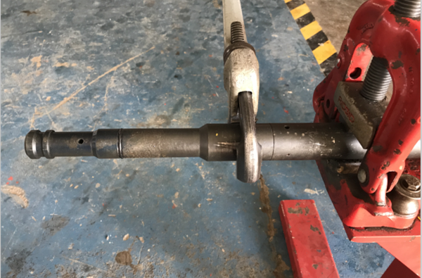
Tool maintenance process
3-1 Removal steps
3-1-1 Disassemble the fishing neck [60] and Equalizing sub [64]
Equalizing sub (64)
fishing neck (60)

Slide 13
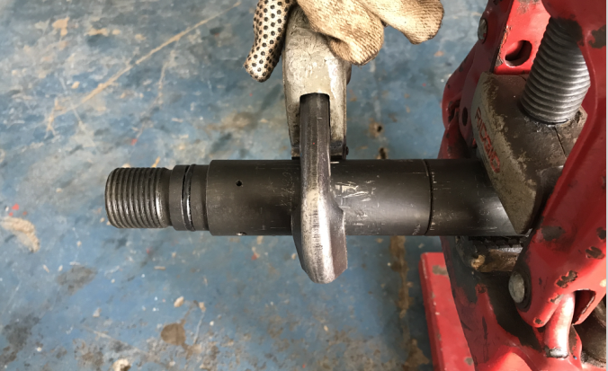
Tool maintenance process
3-1 Removal steps
3-1-2 Remove the Equalizing sub [64] and Equalizing sub connector[65]]
Equalizing sub(64)
Equalizing sub connector (65)

Slide 14
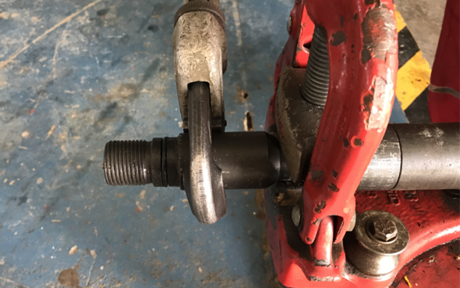
Tool maintenance process
3-1 Removal steps
3-1-3 Remove the Equalizing sub connector [65] from the upper Mandrel [30]
Equalizing sub connector
upper Mandrel

Slide 15
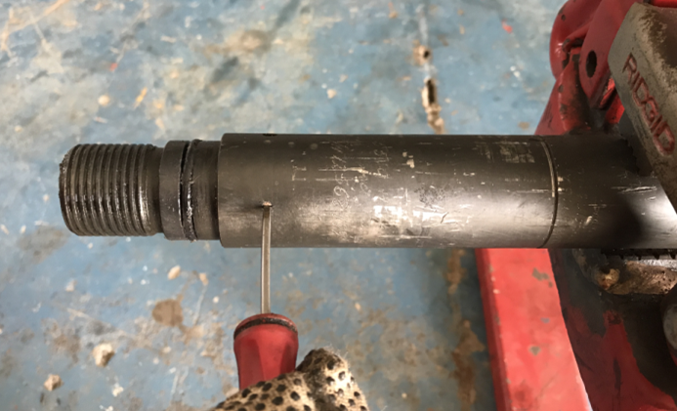
Tool maintenance process
3-1 Removal steps
3-1-4 Remove the shear screw (17) on the Equalizing sub[64]
shear screw (17)
Equalizing sub(64)

Slide 16
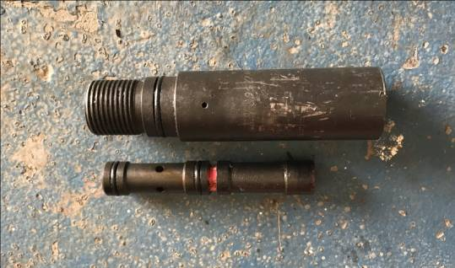
Tool maintenance process
3-1 Removal steps
3-1-5 Separation of Equalizing sub [64] Equalizing sleeve[61] by shock
Equalizing sub(64)
Equalizing sleeve(61)

Slide 17
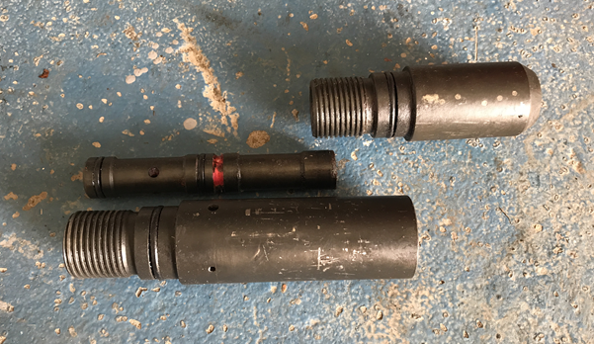
Tool maintenance process
3-1 Removal steps
3-1-6 Equalizing sub part has been disassembled
Equalizing sub connector(65)
Equalizing sub(64)

Slide 18
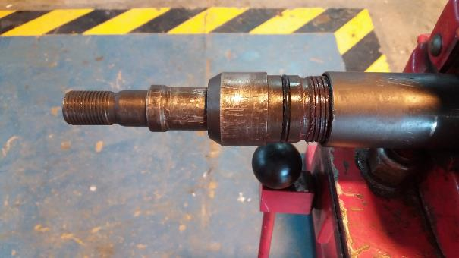
Tool maintenance process
3-1 Removal steps
3-1-7 Remove the end cap [19] from the Bumper Housing[20]
End Cap (19)
Bumper Housing (20)

Slide 19
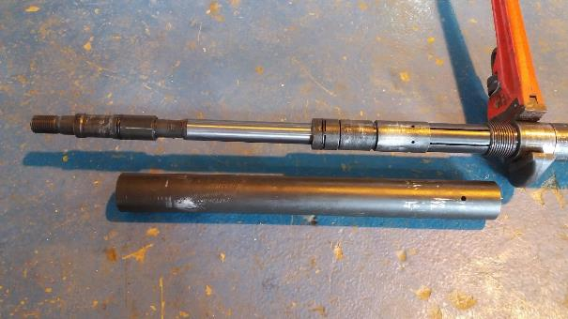
Tool maintenance process
3-1 Removal steps
3-1-8 Remove the Bumper Housing [20] from the collet sub [24]
collet sub [24]
Bumper Housing [20]

Slide 20
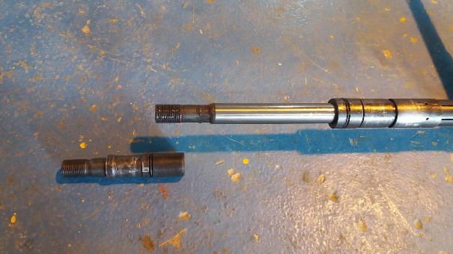
Tool maintenance process
3-1 Removal steps
3-1-9 Remove the upper mandrel [30] from the upper mandrel connector [21]
upper mandrel connector[21]
upper mandrel [30]

Slide 21
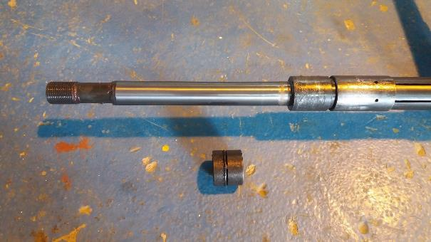
Tool maintenance process
3-1 Removal steps
3-1-10 Remove the piston [22] from the upper mandrel connector[21]
upper mandrel connector[21]
piston [22]

Slide 22
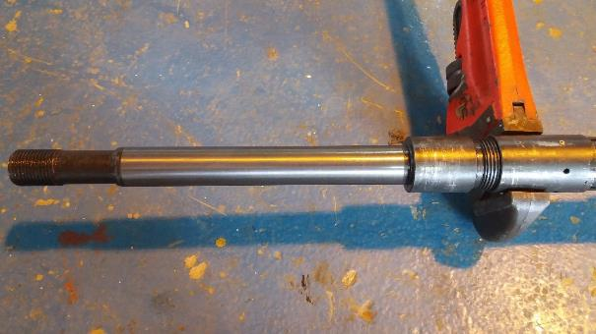
Tool maintenance process
3-1 Removal steps
3-1-11 Remove the upper mandrel connector[21] from the pull release sleeve [23]
upper mandrel connector[21]
pull release sleeve [23]

Slide 23
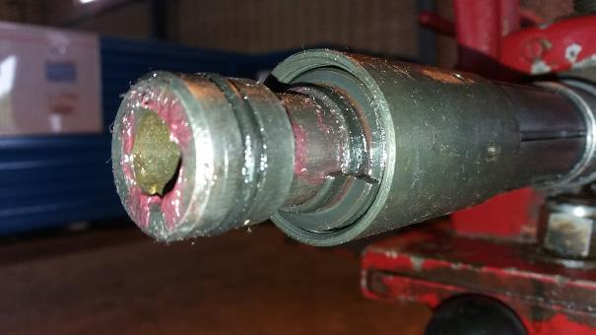
Tool maintenance process
3-1 Removal steps
3-1-12 Remove the split ring [28] in the pull release sleeve [23]
Split Ring[28]
Pull release sleeve[23]

Slide 24
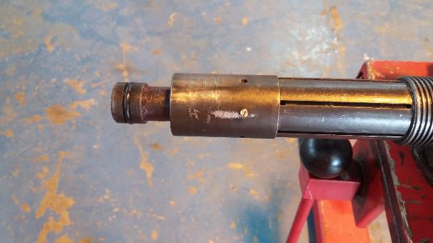
Tool maintenance process
3-1 Removal steps
3-1-13 Remove the shear screw [38] on the pull release sleeve [23]
Shear screw [38]
Pull release sleeve[23]

Slide 25
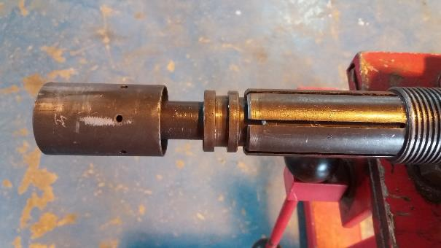
Tool maintenance process
3-1 Removal steps
3-1-14 Remove the pull release sleeve
Pull release sleeve[23]

Slide 26
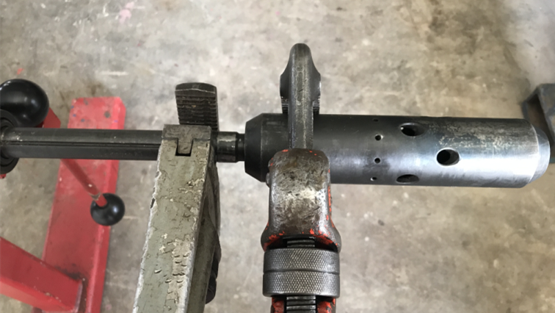
Tool maintenance process
3-1 Removal steps
3-1-15 separate the shear sub [42] from mandrel[36]
Shear sub[42]
Mandrel [36]

Slide 27
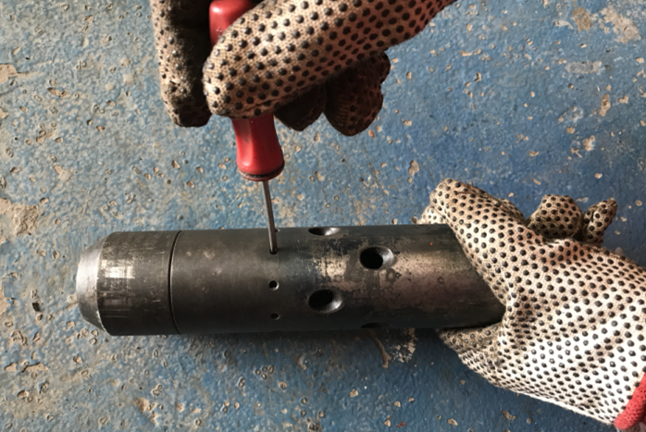
Tool maintenance process
3-1 Removal steps
3-1-16 remove all of the shear screws[18] on the seat catcher[44]
Seat catcher[44]
Shear sub[42]
Shear screw[18]

Slide 28
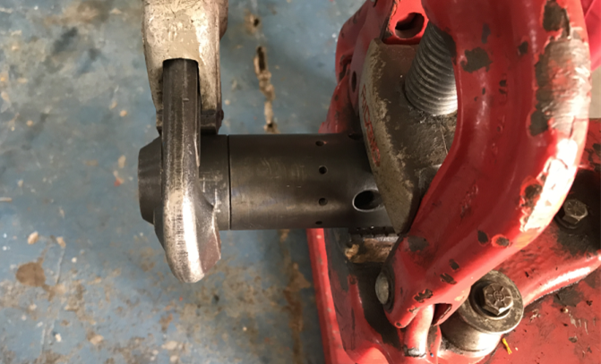
Tool maintenance process
3-1 Removal steps
3-1-17 Separate the shear sub[42] from the seat catcher[44]
Seat catcher[44]
Shear sub[42]

Slide 29
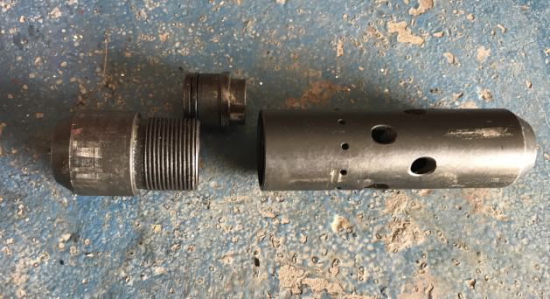
Tool maintenance process
3-1 Removal steps
3-1-18 remove the shear sub[42]and ball seat [45] from the seat catcher[44]
Ball seat[45]
Shear sub[42]
Seat catcher[44]

Slide 30
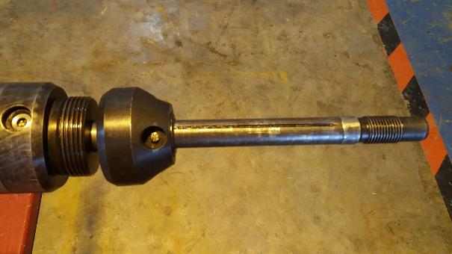
Tool maintenance process
3-1 Removal steps
3-1-19 remove the shear screw[56]and drag out shear adapter [57] from the mandrel
Bottom sub[33]
Shear screw[56]
Shear adapter[57]

Slide 31
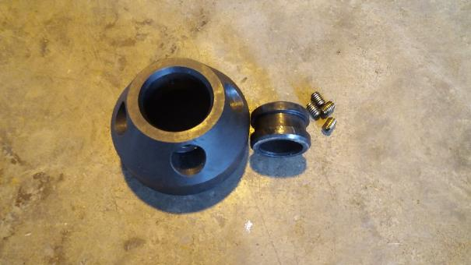
Tool maintenance process
3-1 Removal steps
3-1-20 separate the shear adapter [57] and shear ring [56]
Shear ring [58]
Shear screw [56]
Shear adapter[57]

Slide 32
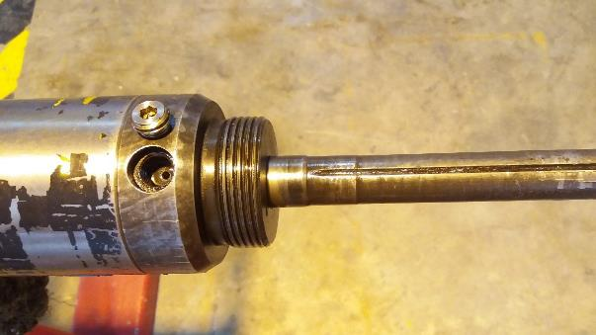
Tool maintenance process
3-1 Removal steps
3-1-21 Remove the bleeder plug [34] from bottom sub [33]
Bleeder plug[34]
Bottom sub[33]

Slide 33
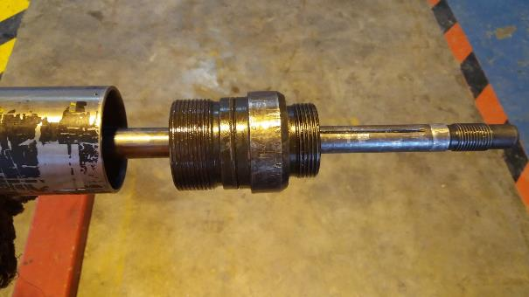
Tool maintenance process
3-1 Removal steps
3-1-22 separate the element [32] from bottom sub [33]
Element[32]
Bottom sub[33]

Slide 34
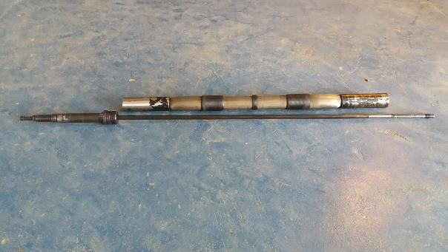
Tool maintenance process
3-1 Removal steps
3-1-23 separate the element [32] from mandrel [ ]
Element[32]
Element[29]

Slide 35
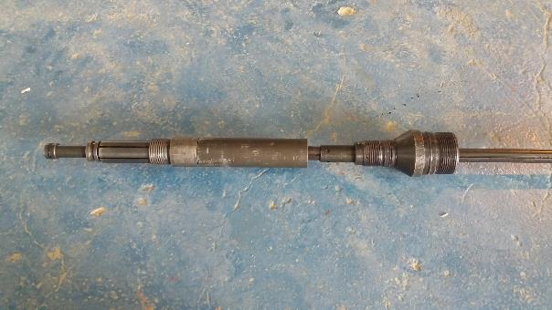
Tool maintenance process
3-1 Removal steps
3-1-24 separate poppet housing[40]from spring housing[29]
Spring housing[29]
Poppet housing[40]

Slide 36
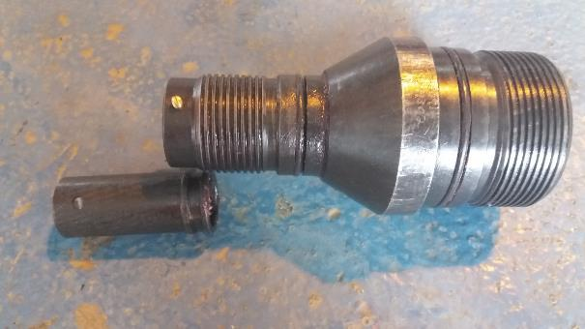
Tool maintenance process
3-1 Removal steps
3-1-25 Open shear screw[16] and separate delayed inflate ring [37]from spring housing[29]
Shear screw[16]
Spring housing[29]
Delayed inflate ring[37]

Slide 37
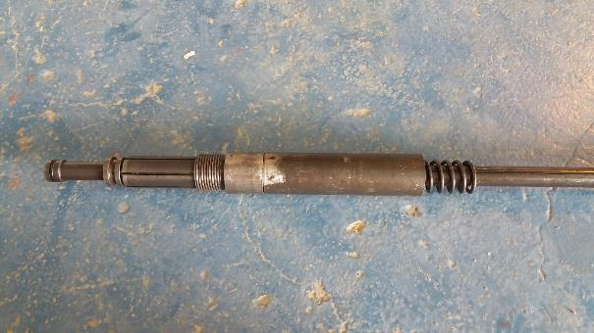
Tool maintenance process
3-1 Removal steps
3-1-26 Remove Poppet Housing[40] from Poppet spring[31]
Poppet spring[31]
Poppet housing[40]
poppet[25]

Slide 38
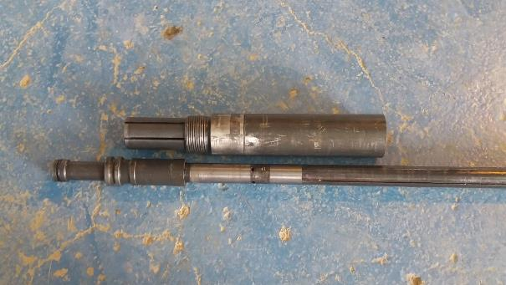
Tool maintenance process
3-1 Removal steps
3-1-27 Remove poppet housing[40]from mandrel[36]
Latch sub[27]
Mandrel[36]

Slide 39
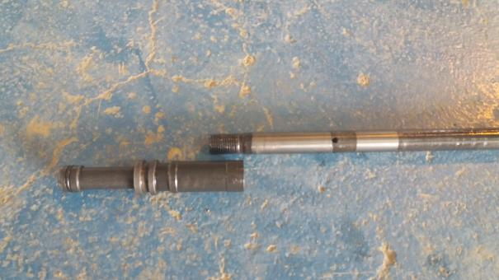
Tool maintenance process
3-1 Removal steps
3-1-28 Remove Latch sub[27] from mandrel[36]
Latch sub[27]

Slide 40
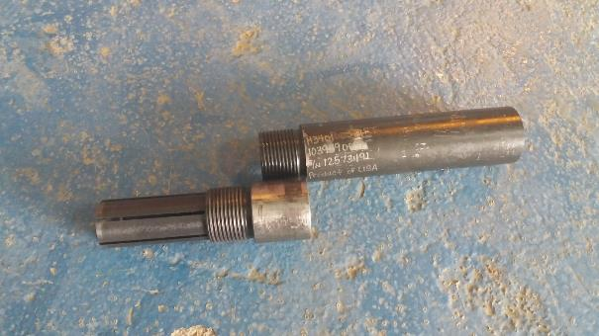
Tool maintenance process
3-1 Removal steps
3-1-29 Separate the collet sub [24] and the poppet housing [40]
Poppet housing[40]
Collet sub[24]

Slide 41
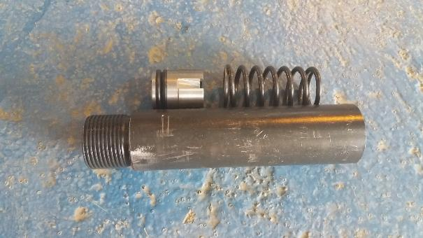
Tool maintenance process
3-1 Removal steps
3-1-30 Remove the poppet[25] and poppet spring[ from poppet housing[40]
poppet[25]
Poppet spring[31]
Poppet housing[40]

Slide 42
Tool maintenance process
3.1 Inspect all O-rings on each component for damage.
3.2 After using diesel oil to remove oil from the components of the tool, clean it with clean water and blow it with compressed air, especially to ensure that the inner wall of the tool barrel is clean.
3.3 Check all parts for damage.
3.4 Replace the damaged part and record the part number of the newly replaced part on the maintenance log sheet.
3.5 Apply a little oil on the surface of each spring and O-ring

Slide 43
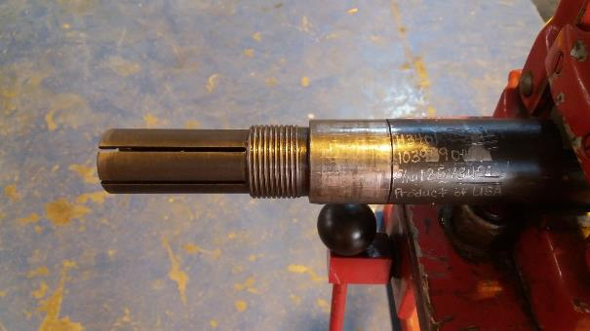
Tool maintenance process
3-2 installation steps
3-2-1 Connect the collet sub [24] to the poppet housing [40]
Poppet housing[40]
Collet sub [24]

Slide 44
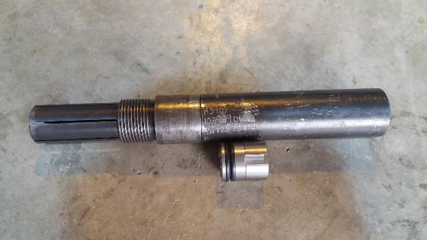
Tool maintenance process
3-2 installation steps
3-2-2 Connect the collet sub [24] to the poppet housing [40]
Poppet housing[40]
poppet[25]

Slide 45
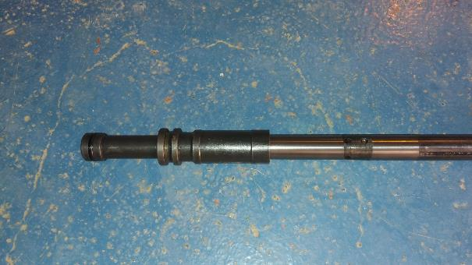
Tool maintenance process
3-2 installation steps
3-2-3 Connect Latch sub[27] to Mandrel[36]
Latch sub[27]
Mandrel[36]

Slide 46
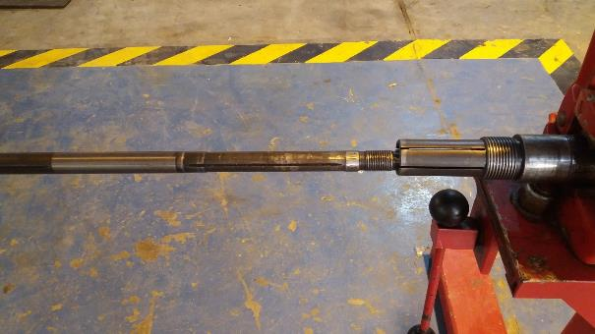
Tool maintenance process
3-2 installation steps
3-2-4 Connect the mandrel [36] to the collet sub [24]
Collet sub [24]
Mandrel[36]

Slide 47
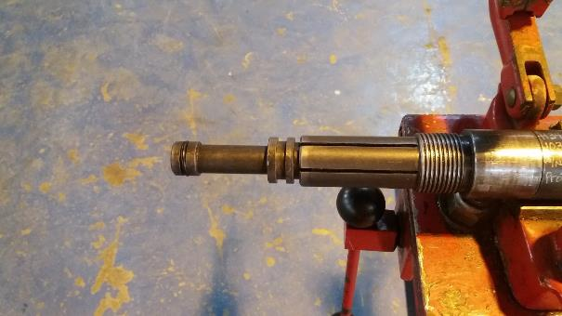
Tool maintenance process
3-2 installation steps
3-2-5 Connect the [27] to the collet sub [24]
Collet sub [24]
Latch sub[27]

Slide 48
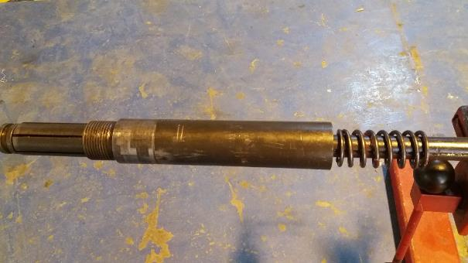
Tool maintenance process
3-2 installation steps
3-2-6 Pass the spring [31] from the right end of the mandrel [36] and push it into the poppet housing [40]]
Mandrel[36]
Poppet spring[31]
Poppet housing[40]

Slide 49
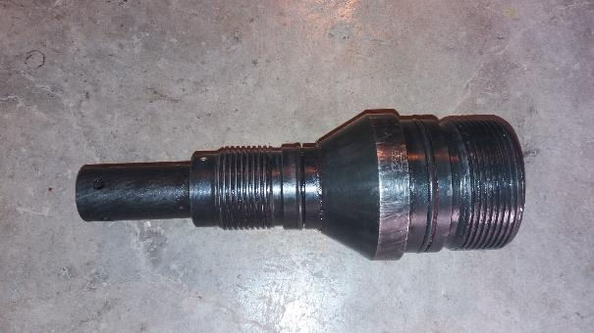
Tool maintenance process
3-2 installation steps
3-2-7 Connect the delayed inflate ring [37] through the shear pin [16] and the spring housing [29]
Spring housing[29]
Shear screw[16]
Delayed inflate ring[37]

Slide 50
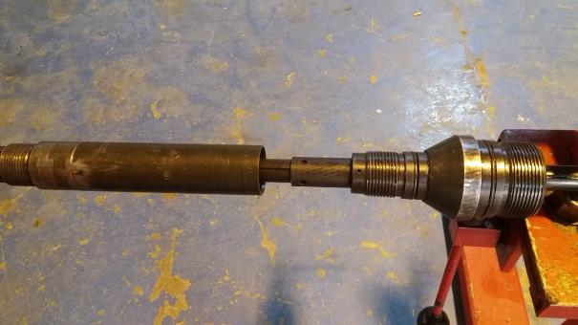
Tool maintenance process
3-2 installation steps
3-2-8 Connect the spring housing [29] and the poppet housing [40]
Poppet housing[40]
Spring housing[29]

Slide 51
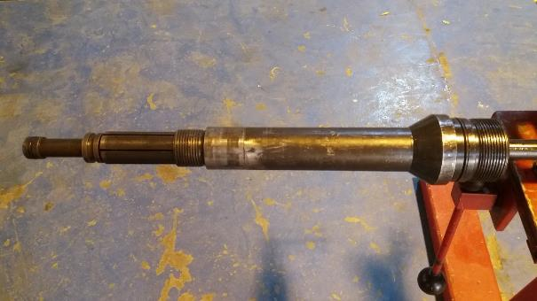
Tool maintenance process
3-2 installation steps
3-2-9 The connection of the joint on the [29] and the expansion valve sleeve [40] is completed
Poppet housing[40]
Spring housing[29]

Slide 52
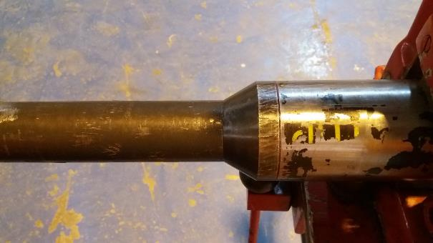
Tool maintenance process
3-2 installation steps
3-2-10 Pass the element [32] from the right end of the mandrel [36] and connect it with the upper joint [29]. Pay attention to distinguish the upper and lower ends of the Element. method: At this time, when holding the buckle on the plastic bucket by hand, the opening direction of the steel strip is opposite to that of the hand, and the feeling is rough; when the shackle is buckled, the opening direction of the steel strip is the same as the direction of the hand movement, and the feeling is smooth.
Spring housing[29]
Element[32]

Slide 53
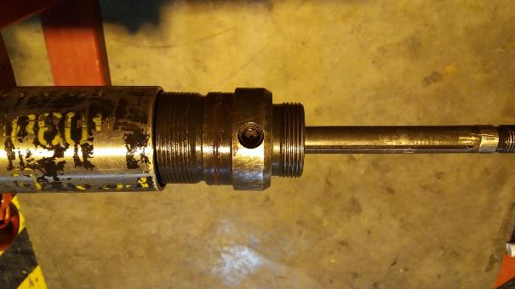
Tool maintenance process
3-2 installation steps
3-2-11 Pass the bottom sub [33] through the right end of the mandrel [36] and connect it with the lower end of the element [32].
Element[32]
Bottom sub[33]
Mandrel[36]

Slide 54
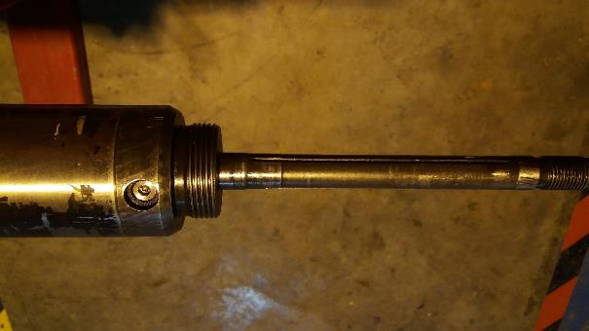
Tool maintenance process
3-2 installation steps
3-2-12 Install the bleeder plug [34]on the bottom sub [33].
Bleeder plug[34]

Slide 55
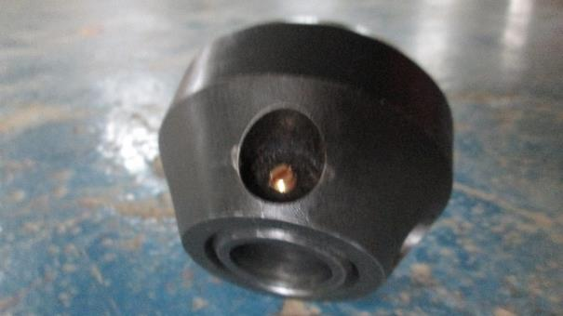
Tool maintenance process
3-2 installation steps
3-2-13 Place the shear ring [58] inside the shear adapter[57] and secure with shear screw [56].
Shear adapter[57]
Shear screw[56]
Shear ring [58]

Slide 56
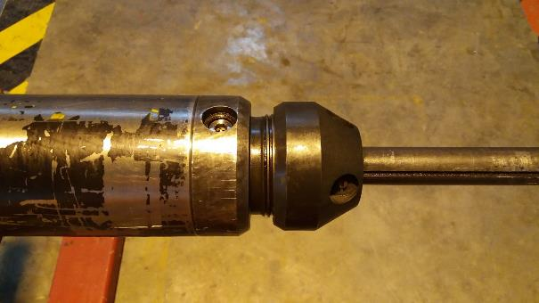
Tool maintenance process
3-2 installation steps
3-2-14 Connect the shear connector [57] to the bottom sub [33]. Be careful not to tighten at this time to prevent damage to the shear screw.
Shear adapter[57]
Bottom sub[33]

Slide 57

Tool maintenance process
3-2 installation steps
3-2-15 Connect the shear sub [42] and the ball seat [45]
Ball seat[45]
Shear sub[42]

Slide 58

Tool maintenance process
3-2 installation steps
3-2-16 Connect the shear sub[42] to the ball seat catcher [44]
Seat catcher[44]
Shear sub[42]

Slide 59

Tool maintenance process
3-2 installation steps
3-2-17 Attach the shear pin [18] to the seat catcher [44]
Seat catcher[44]
Shear screw[18]

Slide 60

Tool maintenance process
3-2 installation steps
3-2-18 Connect the shear sub section [42] and the mandrel [36]
Shear sub[42]
Mandrel [36]

Slide 61

Tool maintenance process
3-2 installation steps
3-2-19 At the other end of the tool, the pull release sleeve [23] is secured to the latch sub [27] via a shear pin [38]. As shown below. The number of pins here determines the lifting force required when the packer is unsealed
Pull release sleeve[23]
Latch sub[27]
Shear screw [38]

Slide 62

Tool maintenance process
3-2 installation steps
3-2-20 Place the split ring [28] into the pull release sleeve [23] and secure it with oil. Pay attention to the direction of the snap ring, as shown below
Split Ring[28]
Pull release sleeve[23]

Slide 63

Tool maintenance process
3-2 installation steps
3-2-21 Connect the upper mandrel connector[21] and pull release sleeve [23]. Shock-absorbing spindle surface is a sealing surface
pull release sleeve [23]
upper mandrel connector[21]

Slide 64

Tool maintenance process
3-2 installation steps
3-2-22 Install the piston [22] to the upper mandrel connector[21]
upper mandrel connector[21]
piston [22]

Slide 65

Tool maintenance process
3-2 installation steps
3-2-23 Insert Upper mandrel[30] to upper mandrel connector[21]
upper mandrel connector[21]
upper mandrel [30]

Slide 66

Tool maintenance process
3-2 installation steps
3-2-24 Slide Bumper Housing[20] to collet sub[24]
upper mandrel [30]
collet sub [24]
Bumper Housing [20]

Slide 67

Tool maintenance process
3-2 installation steps
3-2-25 Insert the end cap [19] to the Bumper Housing[20]
Bumper Housing (20)
End Cap (19)
upper mandrel [30]

Slide 68

Tool maintenance process
3-1 Removal steps
3-2-26 the view of Equalizing sub [64] Equalizing sleeve[61], insert the equalizing sleeve into the equalizing sub.
Equalizing sleeve(61)
Equalizing sub(64)

Slide 69

Tool maintenance process
3-2 Installation steps
3-2-27 Tighten the Equalizing sub Connector [65] to the upper mandrel[30]
Equalizing sub connector(65)
upper Mandrel

Slide 70

Tool maintenance process
3-2 installation steps
3-2-28 Tighten the Equalizing sub[64] to the Equalizing sub connector[]
Equalizing sub connector(65)
Equalizing sub(64)

Slide 71

Tool maintenance process
3-2 installation steps
3-2-29 Tighten the shear screw [17] to the Equalizing sub[64]
shear screw (17)
Equalizing sub(64)

Slide 72

Tool maintenance process
3-2 installation steps
3-2-30 Tighten the fishing neck [60] to the Equalizing sub[64]
Equalizing sub (64)
fishing neck (60)

Slide 73

End Of Maintenance
Maintenance completely

Slide 74
End Of Maintenance
Apply a small amount of butter to all the exposed threads and holes in the tool. Wear wire on both ends of the tool; Move the test pressure qualified tool to the qualified equipment area. Remove the pressure record card and fill in the relevant information (country, region, field name, well name, tool name, date, time, etc.). Fill in the tool maintenance record form, and the coiled tubing engineer must sign and confirm it. Fill in the tool status label and attach it to the wire. Neatly tidy tools, remove safety signs and warning tapes, report forms and drawings, provide convenience for next operation, and clean wastes, such as old seals, on the spot according to waste disposal regulations.

Slide 75

End Of Maintenance
For different sizes of set internal diameters, the packer is subject to different pressure values. It is necessary to select the appropriate number of shear pins according to the well conditions. Specific need to query the tool data sheet (Data sheet). The following table shows the working pressure values in the manual for each shear pin value.

Slide 76

End Of Maintenance
Shear pin number selection

Slide 77
Tool maintenance process
3.1 Inspect all O-rings on each component for damage.
3.2 After using diesel oil to remove oil from the components of the tool, clean it with clean water and blow it with compressed air, especially to ensure that the inner wall of the tool barrel is clean.
3.3 Check all parts for damage.
3.4 Replace the damaged part and record the part number of the newly replaced part on the maintenance log sheet.
3.5 Apply a little oil on the surface of each spring and O-ring

Slide 78
4- End of maintenance
4-1 Tool disposal
4-1-1 Apply a small amount of butter to all the exposed threads and holes in the tool
4-1-2 Wear wire on both ends of the tool
4-1-3 pressure test the tools
4-2 fill in the document
4-2-1 remove the pressure record card and fill in relevant information (country area, oilfield name, well name, tool name, date, time, etc.)
4-2-2 Fill in the tool maintenance record form, CTU engineers must sign and confirm
4-2-3 Fill in the tool status label and attach it to the wire

Slide 79
End Of Maintenance
Apply a small amount of butter to all the exposed threads and holes in the tool. Wear wire on both ends of the tool; Move the test pressure qualified tool to the qualified equipment area. Remove the pressure record card and fill in the relevant information (country, region, field name, well name, tool name, date, time, etc.). Fill in the tool maintenance record form, and the coiled tubing engineer must sign and confirm it. Fill in the tool status label and attach it to the wire. Neatly tidy tools, remove safety signs and warning tapes, report forms and drawings, provide convenience for next operation, and clean wastes, such as old seals, on the spot according to waste disposal regulations.

Slide 80

End Of Maintenance
Note: The tool status label is divided into 3 colors
The green card indicates that the maintenance of the tool, pressure test, and function test are completed. The status is good and can be used.

Slide 81

End Of Maintenance
The yellow card indicates that there are some minor problems in the process of tool maintenance, pressure test, and debugging. However, after the repair or re-maintenance, the function can be restored and reused.

Slide 82

End Of Maintenance
Red card indicates that the tool has been irreparably damaged and can no longer be used

Slide 83
5- Finishing work
Neatly tidy up the tools, remove safety signs and warning tapes, and archive reports and drawings to facilitate the next operation. Clean wastes and other waste seals in accordance with waste disposal regulations.

Slide 84
Thanks for your attention

